Slide 1

Towards General and Efficient Online Tuning for Spark – Paper Presentation
Authors: Yang Li et al.
Stratos Kakalis

Slide 2


Problem & Motivation
▸Spark is a popular distributed computing framework.
▸Spark’s performance depends heavily on correct configuration of parameters.
▸But, manual tuning is hard:
High-dimensional parameter space
Non-linear interactions between parameters
Dynamic Workloads
Notes:
Spark is a popular distributed computing framework often used in big data analytics.
Spark performance is highly dependent on configuration parameters, such as executor memory, cores, and instances.
A Spark application is controlled by up to 160 configuration parameters of which 30 significantly affect job performance.

Slide 3
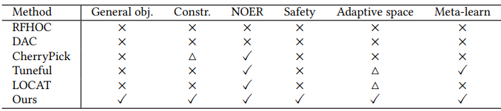
Limitations of Existing Approaches
Current approaches:
Focus too narrowly on runtime.
Require expensive offline evaluations.
Struggle with high-dimensional search spaces.
Rarely consider safety or meta-learning.
Notes:
Many auto-tuning methods have emerged, but they each have limitations.
Some only minimize runtime and don’t support cost or other constraints.
Others require offline evaluation, which is highly expensive and often requires development databases and not production ones
Many struggle in large, high-dimensional config spaces and lack safety guarantees.
In the table:
General obj. : if the framework supports general objectives (not just runtime)
Const: If the framework supports contrained objectives.
NOER: refers to the “No Offline Evaluation Required”, which usually causes high overhead.
Safety represents the ability to achieve safe config. acquisition during search.
Adaptive space notes if it can adjust the search space adaptively to deal with the high-dimensional issue.
Meta-learn indicates whether it utilizes meta-learning techniques to achieve quick convergence.
△ means the method partially supports it with some limitations.

Slide 4

Problem Formalization
Goal: Create a Spark tuning framework that:
Supports general objectives (e.g. resource usage)
Subject to constraints (e.g. max runtime or max resource usage)
Tunes configurations during periodic job executions (no extra overhead)
Ensures safety by avoiding bad configuration spaces during exploration
Formal objective: find the spark config vector that minimizes runtime or resource controlled by a parameter.
Notes:
Spark tuning is framed as an optimization problem.
Formal objective:
$$f(x) = {T(x)}^{β} {R(x)}^{β−1}$$
Where: x is the Spark config vector, T(x) the job runtime, R(x) the resource cost and β ∈ [0,1] parameter that controls the weight of runtime vs resource usage.
The objective combines runtime (T) and resource usage (R) using a weight β.
Resource usage is used as a cost proxy (easier than estimating cost directly). This supports goals like:
Minimizing runtime (β=1)
Minimizing cost (β=0.5)
Resource constraints can be applied

Slide 5
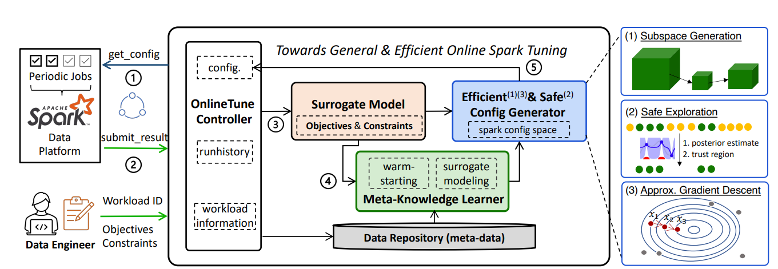
Overview of the OnlineTune System
Key Components:
Online Tune Controller
Surrogate Models
Meta-Knowledge Learner
Config Generator
Data Repository
Notes:
Key Components: *Controller: The Controller acts as the central orchestrator for the entire tuning lifecycle. It interfaces directly with the data platform, receiving job execution triggers and returning configurations to use.
Surrogate Models: These models predict the performance (e.g., runtime, cost) of a Spark job given a specific configuration using Gaussian Processes.
Config Generator: Suggests safe and promising configurations. It restricts tuning to the most influential parameters. Also it uses a dynamically adjusted safe region where constraints are satisfied. (AGD): accelerats convergence with approx. gradients.
Meta-Knowledge Learner: Transfers past tuning knowledge to accelerate convergence.
Data Repository: stores tuning histories, workload info and meta-features
A typical tuning loop runs like this: 1.) Job runs with a select configuration (could be warm-started)
2.) Execution results are recorded
3.) Surrogate model is updates
4.) New config is generated
5.) Repeat until a good config is found or the search budget is depleted.

Slide 6
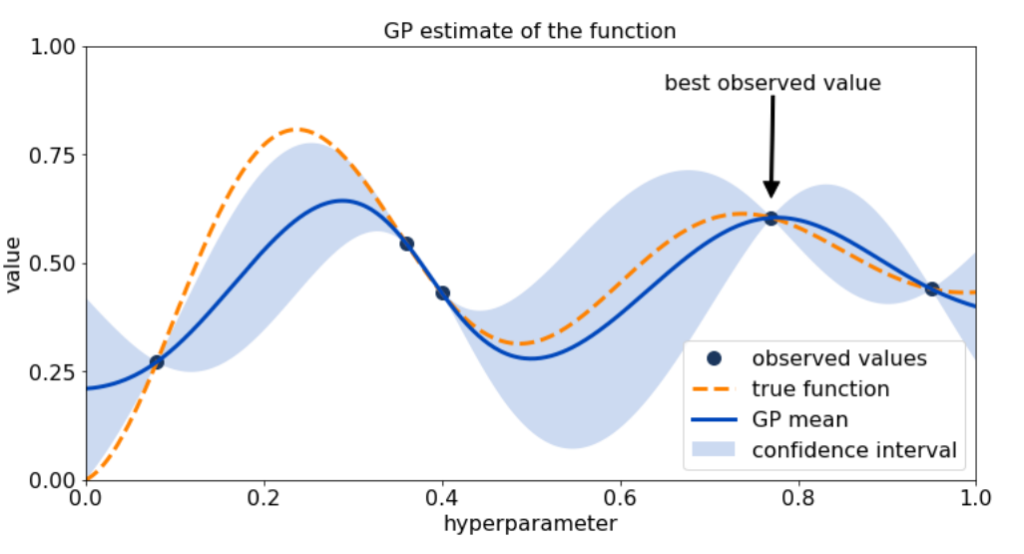
Bayesian Optimization (BO) Backbone
They use BO as the backbone that guides exploration in config space:
Surrogate: Gaussian Processes used to model job performance
Acquisition Function: Expected Improvement with Constraints (EIC) to balance exploration and safety
Dynamic workload modeling via mixed kernels
Notes:
Bayesian Optimization is a strategy for optimizing expensive, black-box functions — where:
You don’t know the function’s formula.
Evaluating it (e.g., running a Spark job) is slow and costly.
The function may be non-linear, noisy, or high-dimensional.
Instead of brute-forcing or randomly testing configurations, BO builds a probabilistic model (called a surrogate) of the function based on past evaluations.
This surrogate estimates:
The performance of new configurations (e.g., expected runtime/cost),
The uncertainty about those estimates (how confident the model is).
Then, BO uses this information to smartly choose the next configuration to try, balancing:
Exploration (trying uncertain regions),
Exploitation (refining good regions).
A surrogate model is a cheap, statistical approximation of the black-box function you’re trying to optimize. In this case they use Gaussian Processes which provide smooth predictions and uncertainty quantification.
Given a few observed points, the GP “fills in” the rest of the function landscape, with confidence intervals.
An acquisition function tells Bayesian Optimization where to sample next. It uses the surrogate model’s predictions and uncertainty to balance exploration and exploitation.
The EIC chooses promising and safe configurations that satisfy constraints.
We also model workload dynamics (e.g., changing data size) using mixed kernels in the GP.

Slide 7
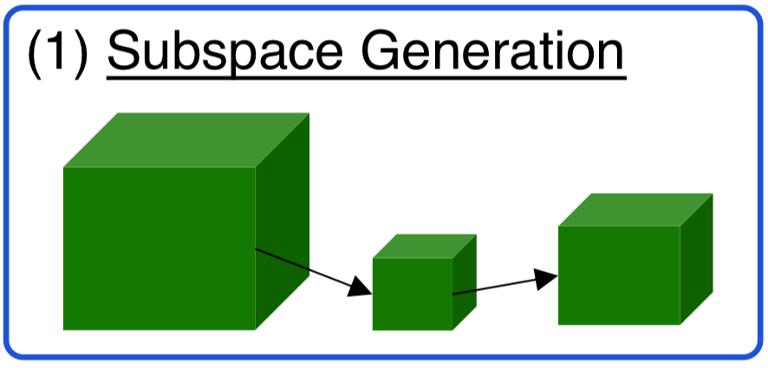
Key Innovation #1: Adaptive Sub-space Generation
Subspace Generation helps us reduce the search space by:
Using FANOVA to find the most influential parameters.
Automatically expand/shrink the subspace based on tuning success
Helps balance convergence speed and result quality
Notes:
Full config space has over 160 Spark parameters which is way too large. We reduce the space using FANOVA, which quantifies parameter importance (including interactions between parameters).
In high-dimensional tuning (like Spark), many parameters have little or no effect.
FANOVA helps identify the most influential ones, so you can focus the search on them.
(analysis of variance)
The framework adapts the sub-space size over time:
Enlarges when we’re making progress,
Shrinks when stuck. This improves efficiency without sacrificing result quality.

Slide 8
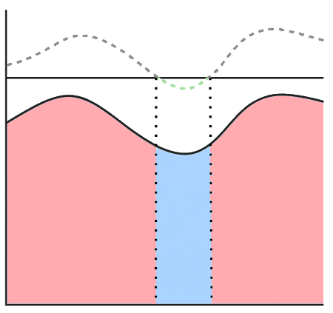
Key Innovation #2: Safe Exploration
A safe configuration is one that satisfies all constraints
UCB
How It Works:
Use the surrogate to predict mean and variance.
Compute upper confidence bound (UCB)
Only consider configs where the predicted worst-case runtime is under a given threshold.
Threshold
Safe
Region
Config Space
Notes:
A safe config: is one that satisfies all constraints (timeout, high resource usage etc)
Core Idea:
Only try configurations likely to be safe
Define a safe region in the config space
Final Selection
Within the safe region, pick the config that maximizes EIC (Expected Improvement × Constraint Satisfaction)

Slide 9
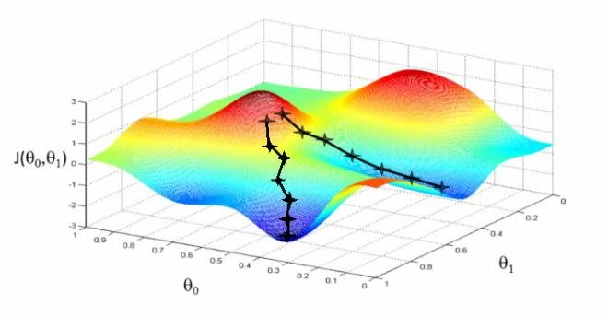
Key Innovation #3: Approximate Gradient Descent (AGD)
▸ Bayesian optimization is sample-efficient but slow in high dimensions. ▸ Approximate Gradient Descent gives directed updates leading to faster convergence and better results.
In Total:
BO explores the config space safely and globally.
AGD accelerates convergence by refining solutions within the known safe zone.
OnlineTune alternates between both, leveraging their strengths.
Notes:
BO is smart with few samples, but when the number of parameters is large, it needs many more to stay effective, losing its efficiency advantage.
AGD makes the search faster and more focused by guiding tuning toward better configurations using gradient-like steps, especially useful when BO alone is slow in high dimensions.
AGD speedup originates from:
BO needs to optimize an acquisition function over the whole parameter space (costly in high dimensions).
AGD can update configs directly using approximate gradients, skipping expensive searches.
By alternating between AGD and BO the system balances exploration vs exploitation with a convergence guarantee
Implementation Details: f(x) = T(x) ^ b * R(x) * 1-b
The resource function is differentiable, so we use partial gradients. For runtime, we use finite differences estimated from the surrogate.

Slide 10
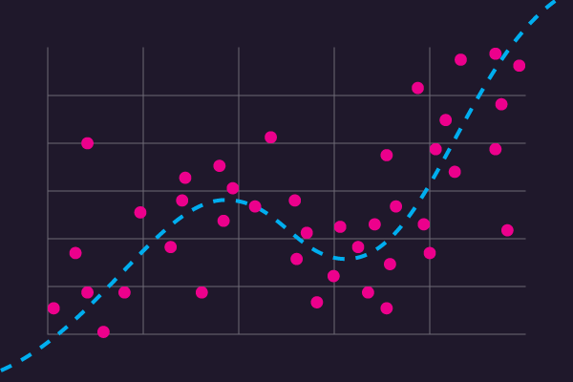


Key Innovation #4: Meta-Learning
The Meta-Knowledge Learner:
▸ Extracts meta-features from Spark logs. (job size, CPU use…)
▸ Trains regression model to measure task similarity in order to:
Warm-start new tasks with good initial configs
Improve surrogate modeling using ensemble of past models
Notes:
We often tune similar jobs again and again. So why start from scratch?
We can extract meta-features from Spark logs, job size, CPU use, read/write intensity, etc. (75 features) Then train a regression model to measure task similarity. (Each task is defined by the 75 features) This allows:
Warm-starting new tasks with top configs from similar past jobs.
Building meta-surrogate ensembles to improve early predictions and convergence.

Slide 11
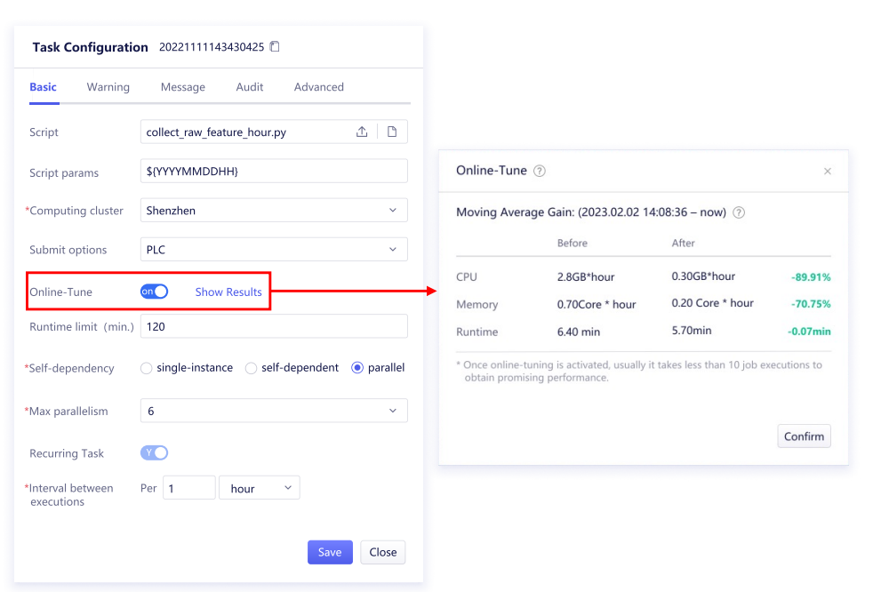
Implementation & Deployment
OnlineTune is:
Implemented as a cloud service at Tencent
Tuning periodic jobs hourly/daily
No extra job runs required (true online tuning)
Web interface for users
Notes:
They deployed OnlineTune as a cloud service within Tencent’s internal data platform. Users specify goals (e.g., cost minimization) and constraints, then activate online tuning. A web interface shows tuning progress. Tuning is integrated directly with recurring production jobs, with no extra resource cost.

Slide 12
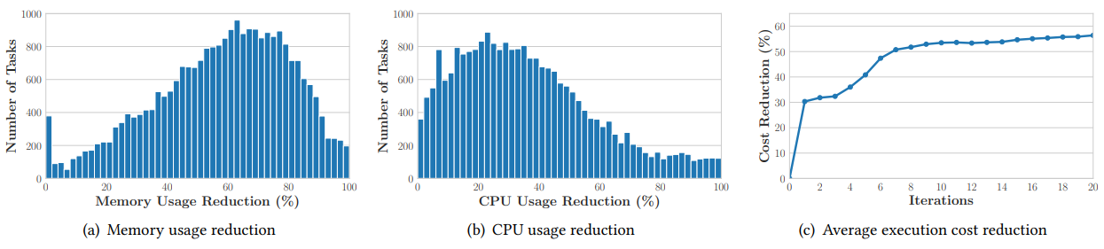
Results and Insights
▸25k in-production Spark jobs executed:
▸Avg. savings:
Memory: 57%
CPU: 35%
Runtime: 11%
Notes:
The framework was evaluated on 25,000 real Spark jobs at Tencent. The results are impressive:
57% average memory reduction
35% CPU reduction
~11% runtime savings Most tasks converge to near-optimal configs in under 10 iterations.
Also in the paper they perform extensive ablation studies and experiments proving that each component trully aids the entire framework. The conclusions are:
Sub-space adaptation improves efficiency
Meta-Learning vastly improves early performance.
AGD reduces the costs a further ~8% than vanilla BO

Slide 13
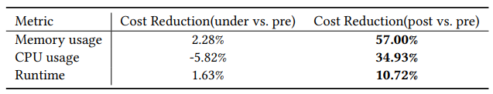
Tuning Overhead
▸For 25k in-production Spark jobs:
▸Tuning lasts 20 iterations
▸ Only 4 extra executions are needed to make up for the tuning overhead.
Notes:
Tuning Overhead:
The framework only performs tunning for the first 20 iterations, were some additional overhead is noted. After that though the framework stops the tuning and applies the best found config.
They claim that the service needs no more than 4 extra executions (post-tuning) to amortize the CPU usage overhead on average

Slide 14
Conclusion
▸OnlineTune is the first general & efficient online tuning framework for Spark
▸It solves challenges of functionality, overhead, and efficiency
▸Thorough evaluation and benchmarks prove it’s the SoTA for Spark tuning.
▸Future work will focus on extending this framework to support more data
analytics systems. (Spark, Hive, Databricks etc…)
Notes:
They also evaluated on HiBench benchmarks like KMeans, Bayes, PageRank. Compared to baselines like Random Search, CherryPick, Tuneful, and LOCAT, onlinetune consistently outperforms. Plots show:
Higher speedup in runtime
Greater cost reduction across tasks Even under a small budget (30 iterations), the approach dominates due to fast convergence and better exploration.
In summary, the team built a general-purpose online tuning framework for Spark. Key innovations:
Generalized tuning formulation
Bayesian Optimization with safe exploration
Sub-space adaptation, gradient approximation, and meta-learning It works at scale, in real production environments, and delivers strong performance across diverse goals.

Slide 15
Q/A
Thank you for your time!

